Slide 1


A MULTILATERAL TAX TREATY
DR. D.M. BROEKHUIJSEN
20 september 2018
Vereniging voor Belastingwetenschap 2018

Slide 2
OESO Modelverdrag 1963
Land A
Land B
OECD Modelverdrag 1977
OECD Modelverdrag 2003
Land C
Land D

Slide 3
1. Aanpassen verdragen
Country
Country
Country
Country
2. Level playing field

Slide 4

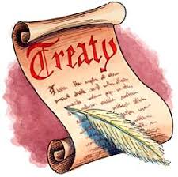
INHOUD?
PROCEDURES?
WIE?

Slide 5
TWEE PERSPECTIEVEN

Slide 6
1.

Slide 7
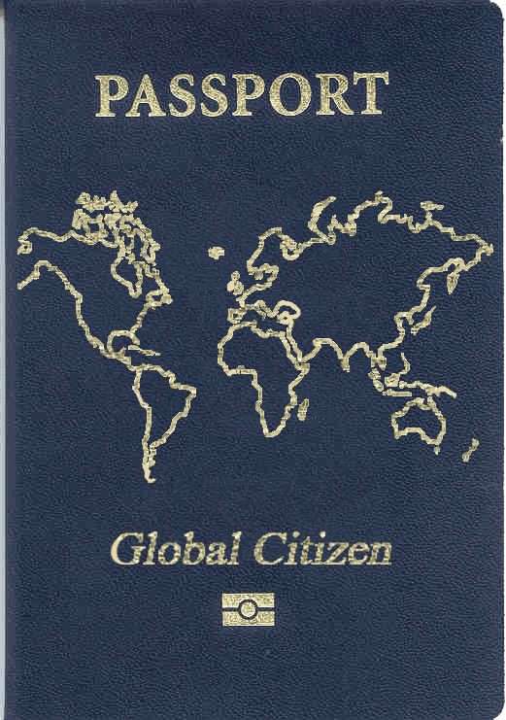
Gedachte-experiment

Slide 8



Eerlijke procedure!

Slide 9
2.

Slide 10




Slide 11



Land
15%
5%
10 %!
Land
land
0%

Slide 12
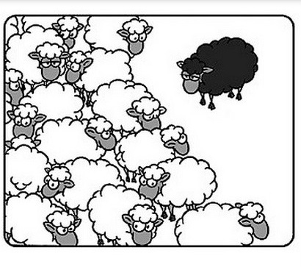
1. Opt outs/reservations

Slide 13

2.
2. ‘rules of the road’

Slide 14
Country
???
???
Country
Country
???

Slide 15



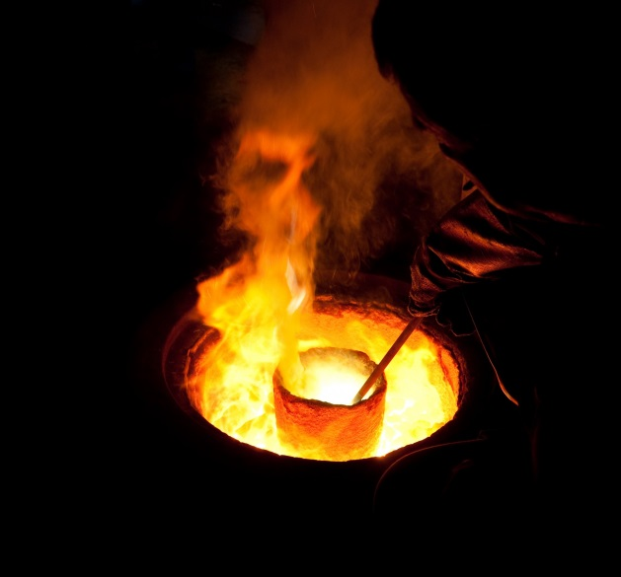
Notes:
Facilitation of continuous, transparent and ‘fair’ discussions
Small degree of institutionalization (no more than necessary)
Facilitate ‘learning’ and exchange of information
‘Real’ solutions to collective action problems of international tax law may be reached over time.
States may ‘learn’ to deal with uncertainty about the state of the world
E.g.: ‘increasing’ demand for ‘fairer’ international tax rules
Formal multilateral agreement reduces costs of bilateral negotiations (i.e., meeting in New York on 22nd of January)
Similar to UN Framework Convention on Climate Change (‘dividing the carbon pie’ = ‘dividing the tax pie’)

